Slide 1




Data Structure
Class
viii
Lab 21
Supported by
Powered By

Slide 2

Lists
List is a smart data type. It is also a built in Data Structure in Python
Supported by
Powered By

Slide 3
Access Item in List
>>> c = [‘apple’, ‘mango’, ‘banana’]
>>>c
['apple', 'mango', 'banana']
>>>
You need to use third bracket to declare list
Supported by
Powered By

Slide 4
Replace Item in List
>>> c = [‘apple’, ‘mango’, ‘banana’]
>>>c
['apple', 'mango', 'banana']
>>> c[0] = ‘pine apple’
>>>c
[‘pine apple', 'mango', 'banana']
To replace item assign index number and change the item
Supported by
Powered By

Slide 5
Delete Item From List
>>> c = [‘apple’, ‘mango’, ‘banana’]
>>>c
['apple', 'mango', 'banana']
>>> c.remove(‘apple’)
>>>c
['mango', 'banana']
To replace item assign index number and change the item
Supported by
Powered By

Slide 6
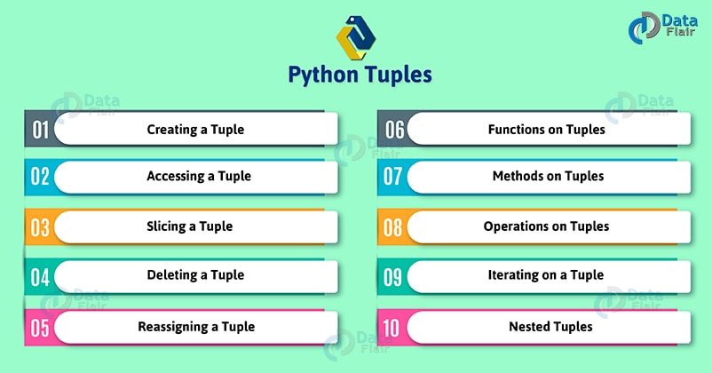
Tuple
Tuple is also one kind of list. But List and Tuple are not same.
Supported by
Powered By

Slide 7
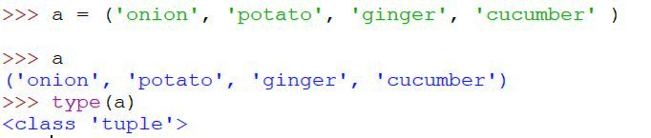
Access Item in Tuple
Same as list except first bracket
Supported by
Powered By

Slide 8
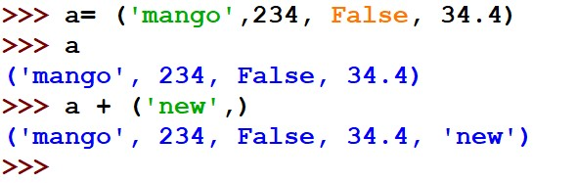
Add New Item in Tuple
Same as list except first bracket
Supported by
Powered By

Slide 9


SET
Literally Mathematics set and Python’s set are same thing.
Supported by
Powered By

Slide 10
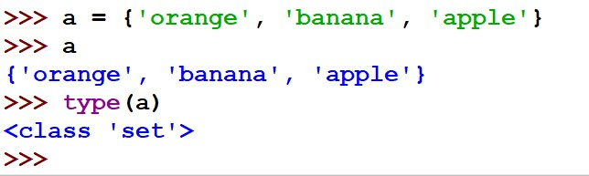
Access Item
Use second bracket to declare set
Supported by
Powered By

Slide 11
Removing Item From Set
Use second bracket to declare set
Supported by
Powered By

Slide 12

Thank You!
Stay Connected with Python

